Slide 1
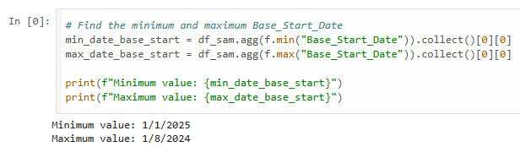

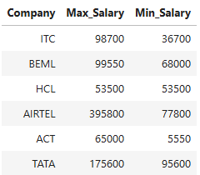

min() & max()
agg()
groupBy()
describe()
collect()
Window Functions
Get Maximum and Minimum Value from Column?

